Slide 1

MANAGEMENT OF NATURAL RESOURCES
Kulhs in Himachal Pradesh

Slide 2
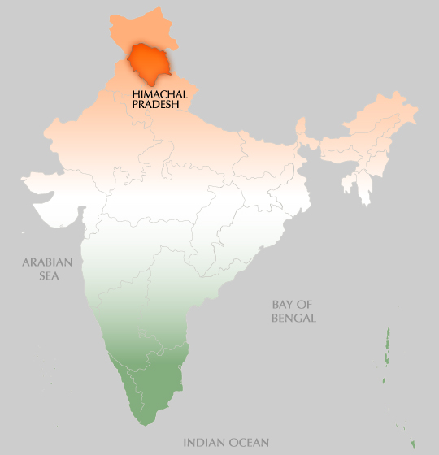
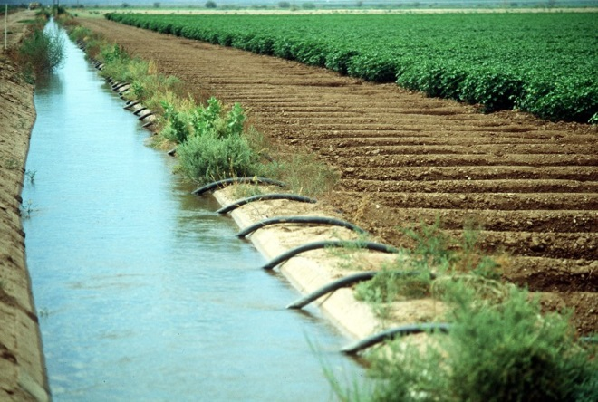
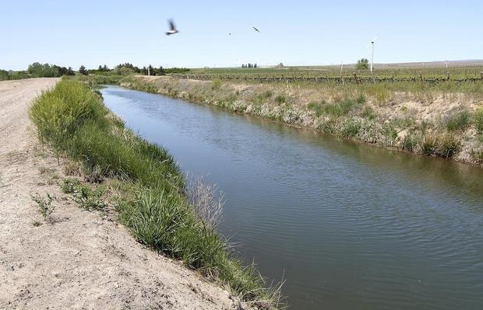
Kulhs in Himachal Pradesh
Parts of Himachal Pradesh had evolved a local system of canal irrigation called kulhs over four hundred years ago.

Slide 3
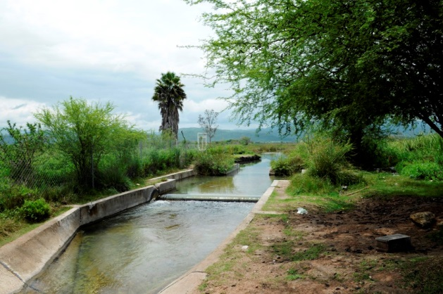
The water flowing in the streams was diverted into man-made
channels which took this water to numerous villages down the hillside.

Slide 4
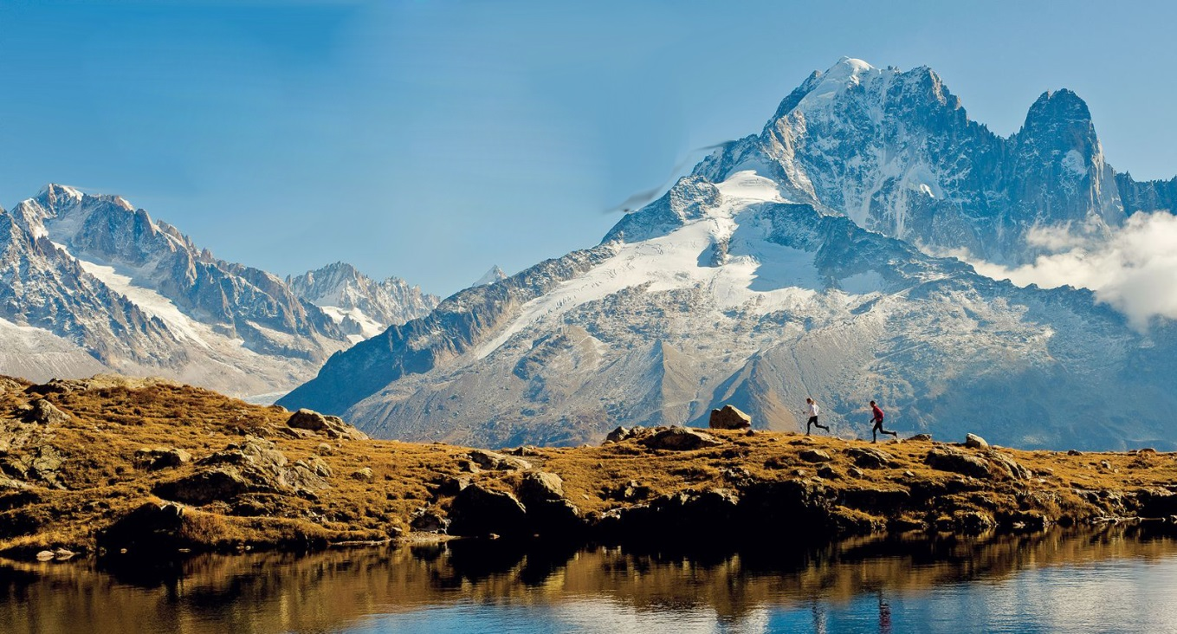
The management of the water flowing in these kulhs was by common agreement among all the villages.
Interestingly, during the planting season, water was first used by the village farthest away from the source of the kulh, then by villages progressively higher up.

Slide 5
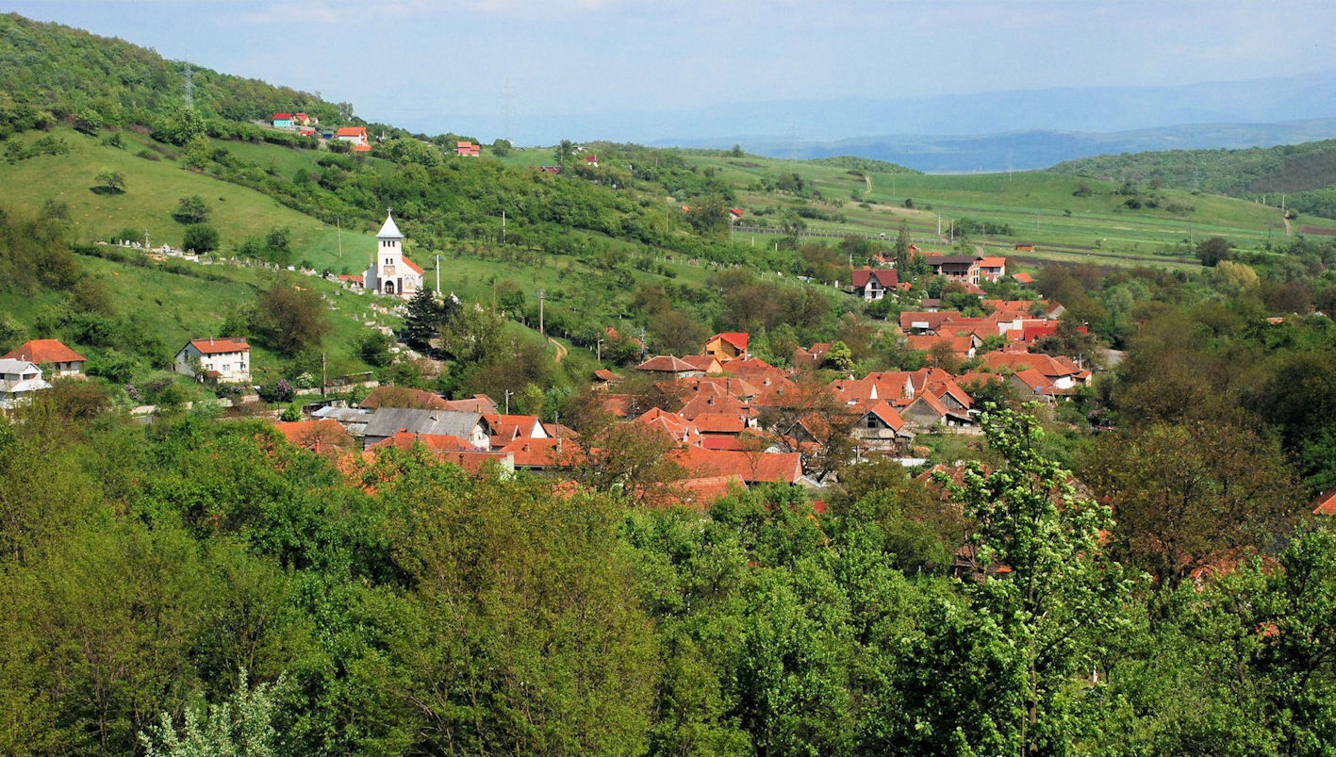
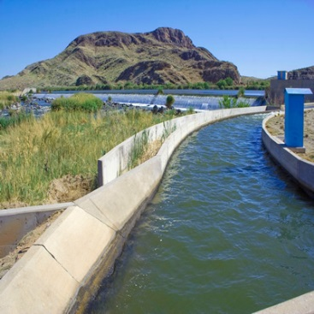
The water flowing in the streams was diverted into man-made channels which took this water to numerous villages down the hillside.

Slide 6
Thank You

